Slide 1

BASIC ELECTRICAL ENGINEERING
D. C. KULSHRESHTHA,
PowerPoint Slides
PROPRIETARY MATERIAL. © 2010 The McGraw-Hill Companies, Inc. All rights reserved. No part of this PowerPoint slide may be displayed, reproduced or distributed in any form or by any means, without the prior written permission of the publisher, or used beyond the limited distribution to teachers and educators permitted by McGraw-Hill for their individual course preparation. If you are a student using this PowerPoint slide, you are using it without permission.
Next

Slide 2
Chapter 4
Network Theorems
D.C. Kulshreshtha
Next

Slide 3
Topics to be Discussed
Superposition Theorem.
Thevenin’s Theorem.
Norton’s Theorem.
Maximum Power Transfer Theorem.
Maximum Power Transfer Theorem for AC Circuits.
Millman’s Theorem.
Reciprocity Theorem.
Next

Slide 4
Network Theorems
Some special techniques, known as network theorems and network reduction methods, have been developed.
These drastically reduce the labour needed to solve a network.
These also provide simple conclusions and good insight into the problems.
Next

Slide 5
Superposition Theorem
The response (current or voltage) in a linear network at any point due to multiple sources (current and/or emf) (including linear dependent sources),
can be calculated by summing the effects of each source considered separately,
all other sources “turned OFF” or “made inoperative”.
Next

Slide 6
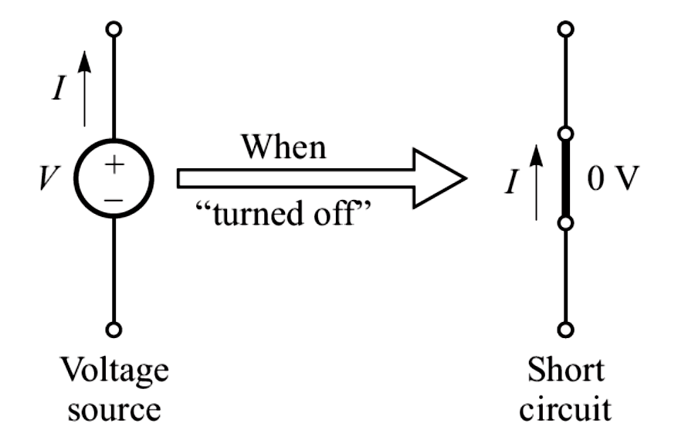
“Turning off” the sources
Next

Slide 7
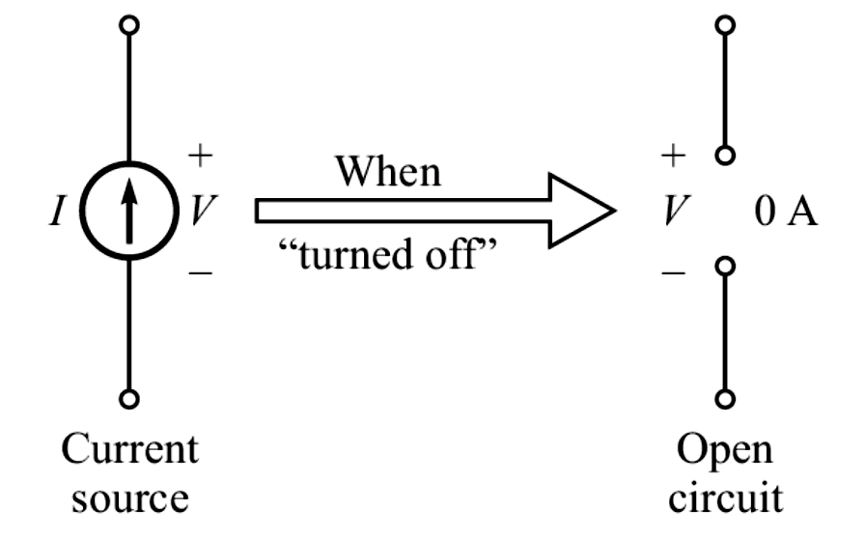
Next

Slide 8
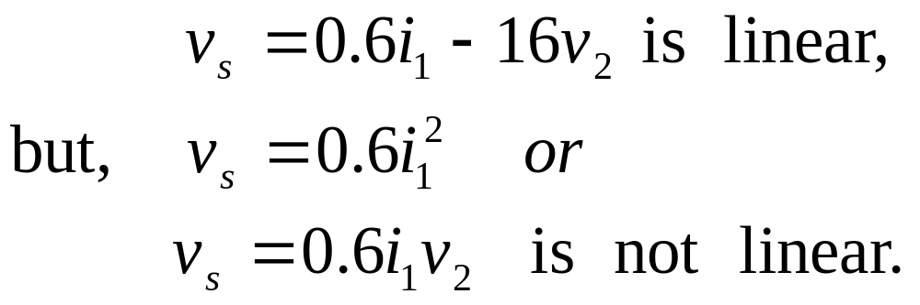
Linear Dependent Source
It is a source whose output current or voltage is proportional only to the first power of some current or voltage variable in the network or to the sum of such quantities.
Examples :
Next

Slide 9
Application
Problem : Consider two 1-V batteries in series with a 1-Ω resistor. Let us apply the principle of superposition, and find the power delivered by both the batteries.
Solutions : Power delivered by only one source working at a time is
P₁ = 1 W
Next

Slide 10
Therefore, the power delivered by both the sources,
P = 2P₁ = 2 W
The above answer is obviously wrong, because it is a wrong application of
the superposition theorem.
Next

Slide 11
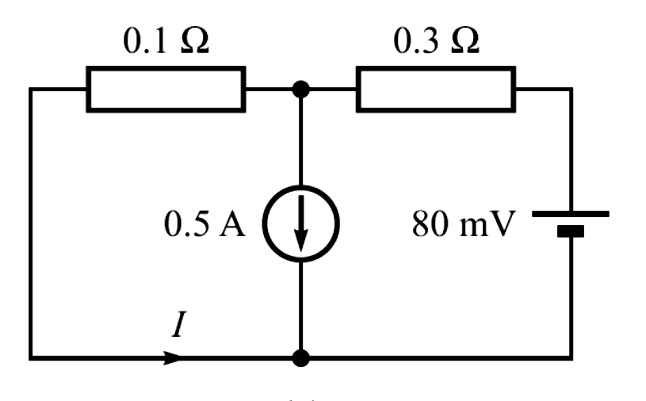
Example 1
Find the current I in the network given, using the superposition theorem.
Next

Slide 12
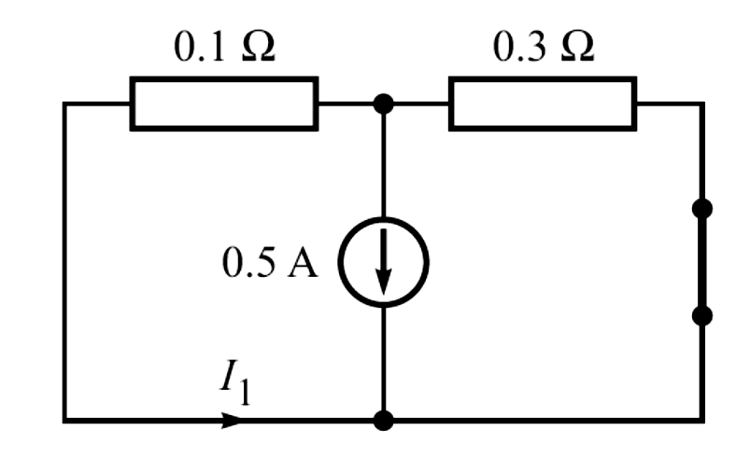
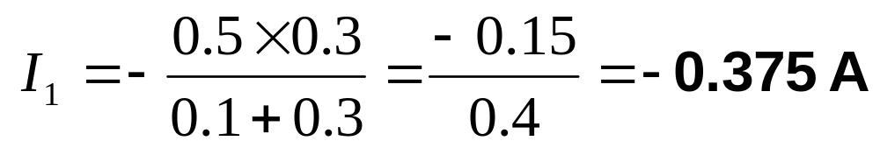
Solution :
Next

Slide 13
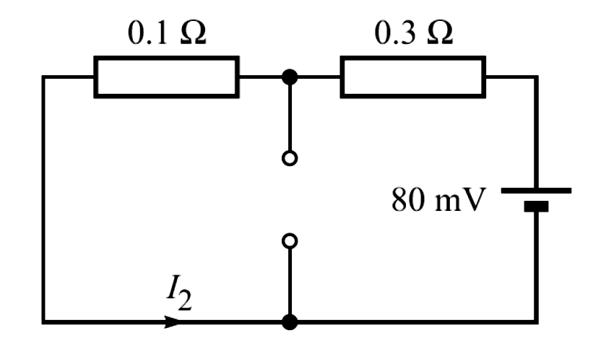
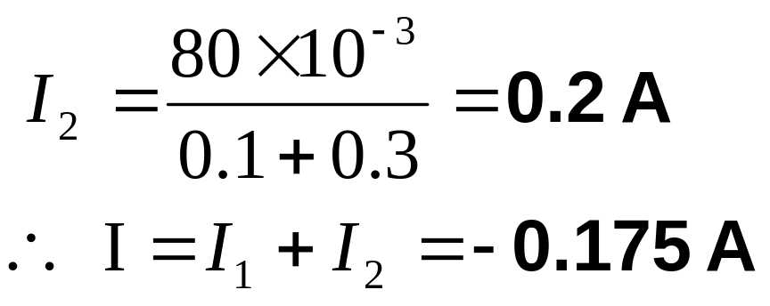
Next

Slide 14
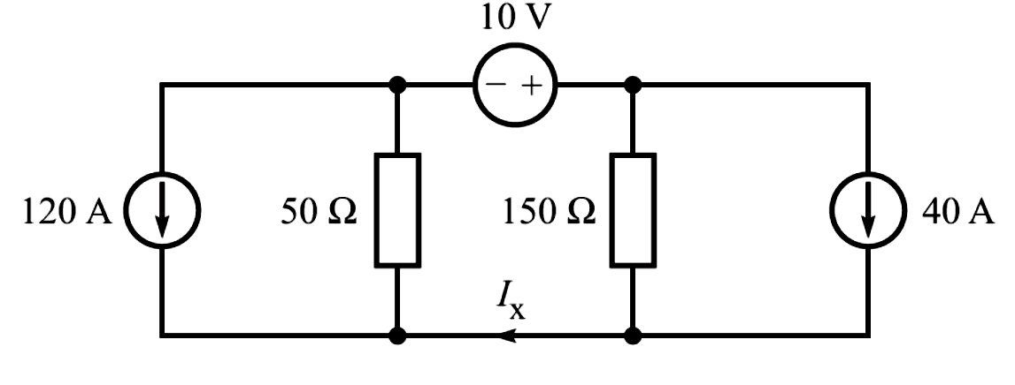
Example 2
Using superposition theorem, find current i_{x} in the network given.
Next

Slide 15
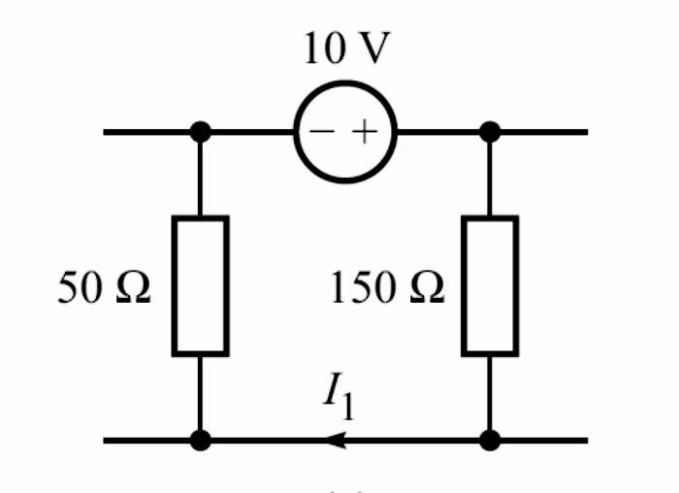
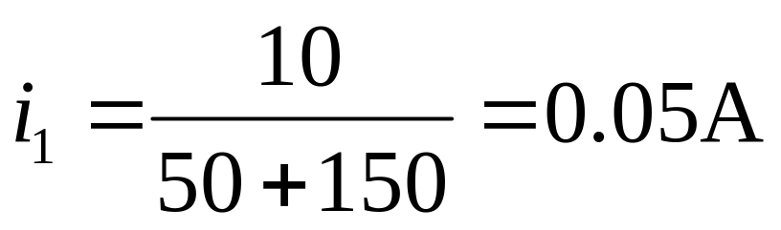
Solution :
Next

Slide 16
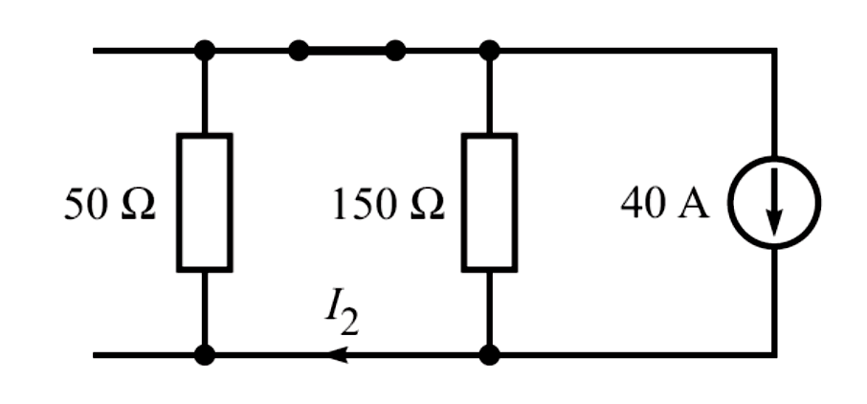
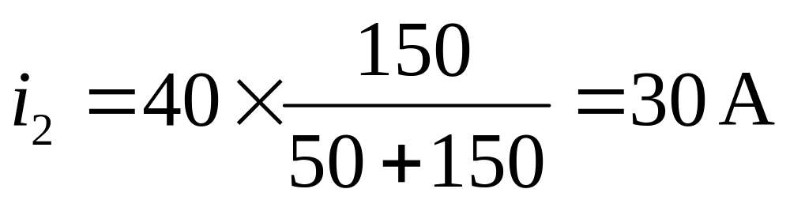
Next

Slide 17
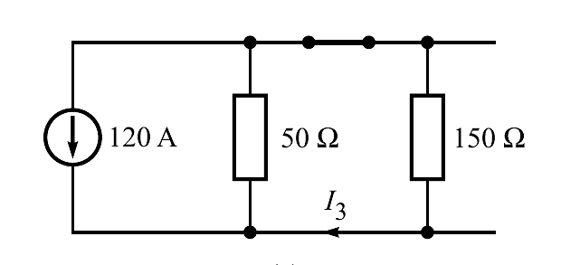
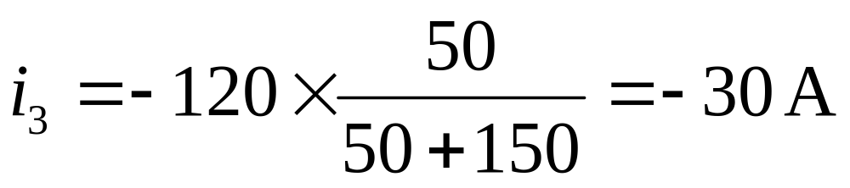
Next

Slide 18
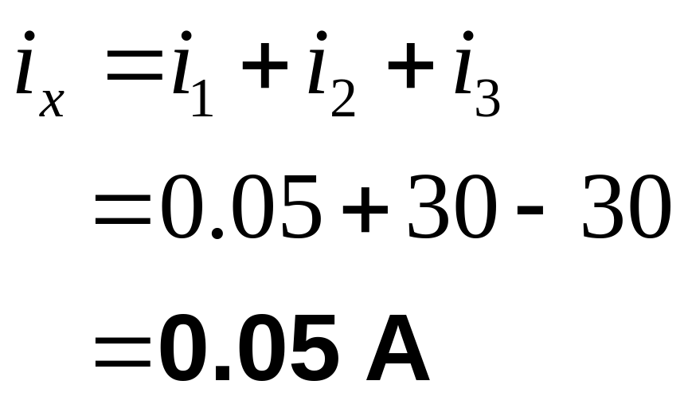
Next

Slide 19
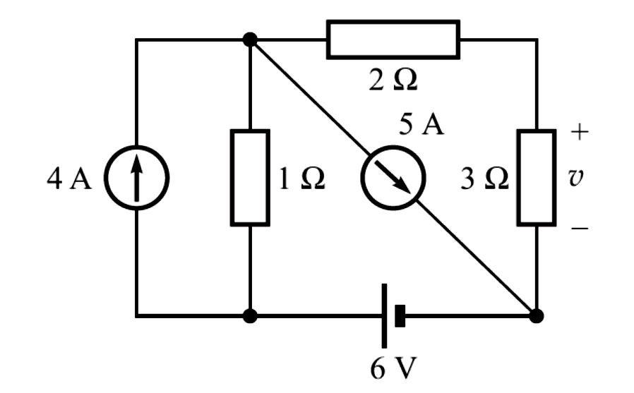
Benchmark Example 3
Find voltage v across 3-Ω resistor by applying the principle of superposition.
Next

Slide 20
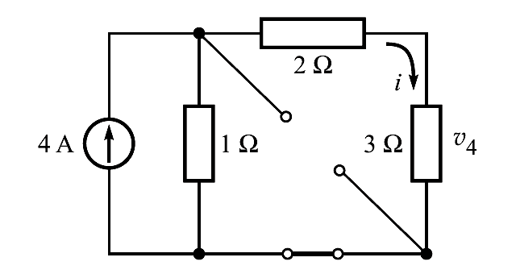
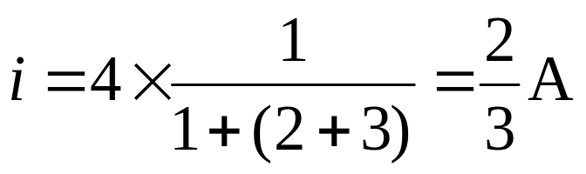
Solution :
Using current divider,
Next

Slide 21
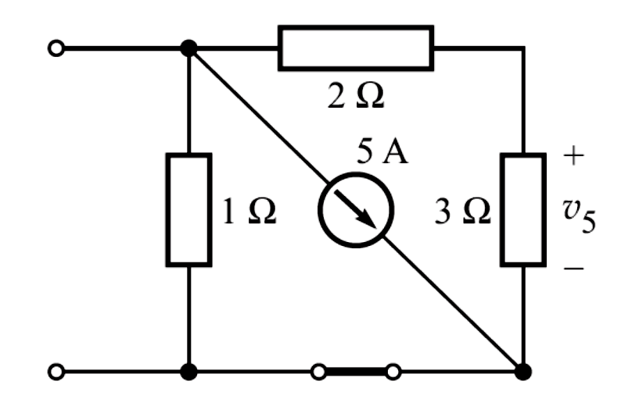
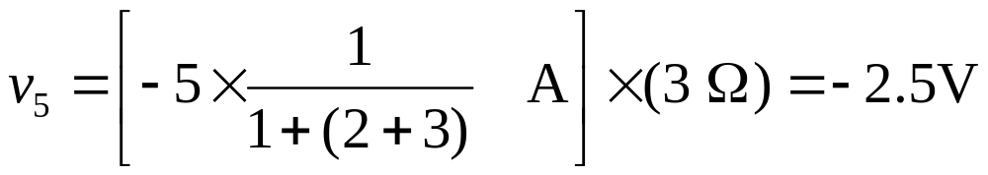
Using current-divider, the voltage v₅ across 3-Ω
Next

Slide 22
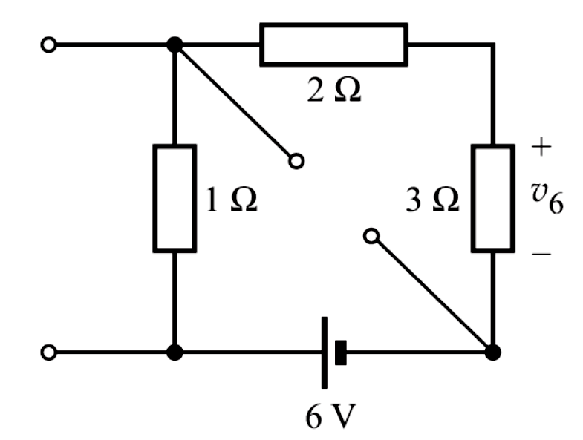
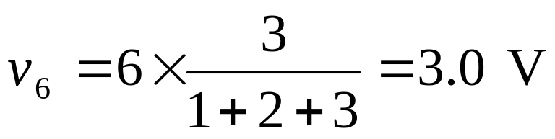
By voltage divider,
Next

Slide 23
Thevenin’s Theorem
It was first proposed by a French telegraph engineer, M.L. Thevenin in 1883.
There also exists an earlier statement of the theorem credited to Helmholtz.
Hence it is also known as Helmholtz-Thevenin Theorem.
It is useful when we wish to find the response only in a single resistance in a big network.
Next

Slide 24
Thevenin’s Theorem
Any two terminals AB of a network composed of linear passive and active elements may by replaced by a simple equivalent circuit consisting of
  an equivalent voltage source V_{oc}, and
  an equivalent resistance R_{th} in series.
Next

Slide 25
The voltage V_{oc} is equal to the potential difference between the two terminals AB caused by the active network with no external resistance connected to these terminals.
The series resistance R_{th} is the equivalent resistance looking back into the network at the terminals AB with all the sources within the network made inactive, or dead.
Next

Slide 26
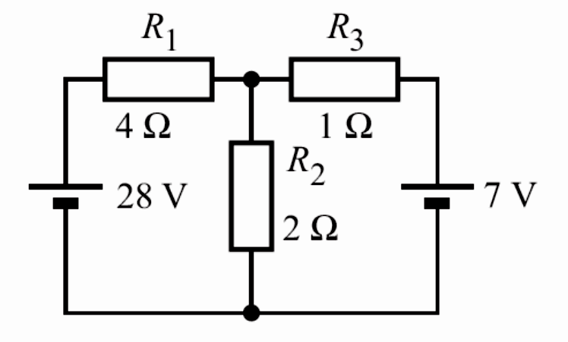
Illustrative Example 3
Using Thevenin’s theorem, find the current in resistor R₂ of 2 Ω.
Next

Slide 27
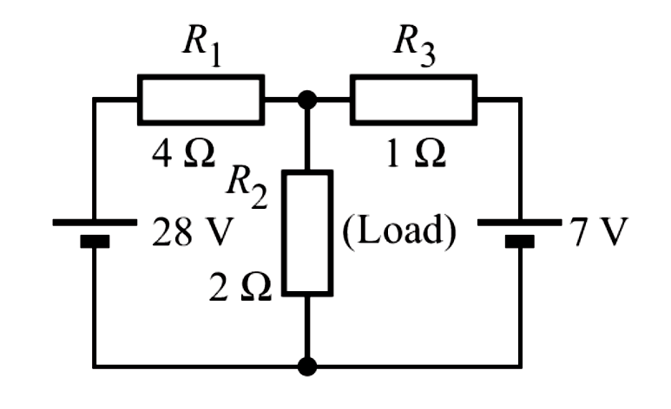
Solution :
1. Designate the resistor R₂ as “load”.
Next

Slide 28
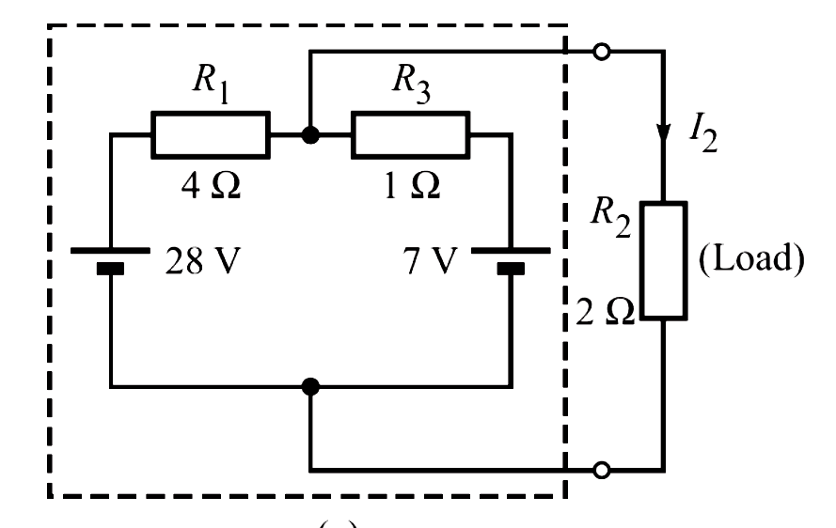
2. Pull out the load resistor and enclose the remaining network within a dotted box.
Next

Slide 29
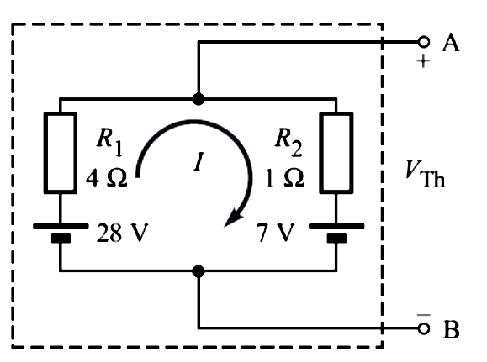
3. Temporarily remove the load resistor R₂, leaving the terminals A and B open .
Next

Slide 30
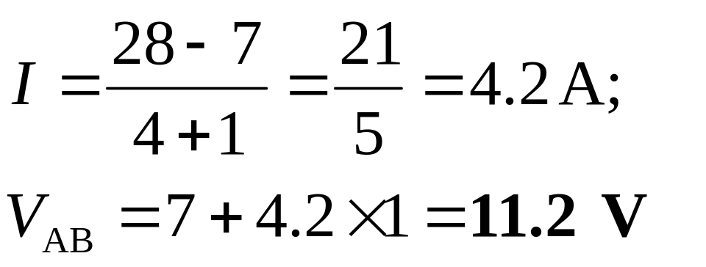
4. Find the open-circuit voltage across the terminals A-B,
5. This is called Thevenin voltage, V_{Th} = V_{AB} = 11.2 V.
Next

Slide 31
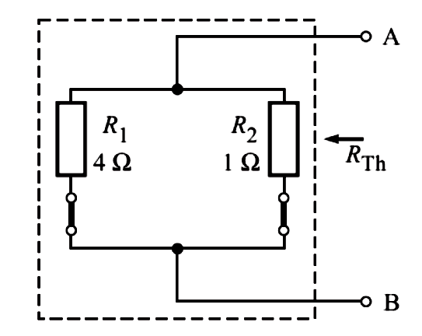
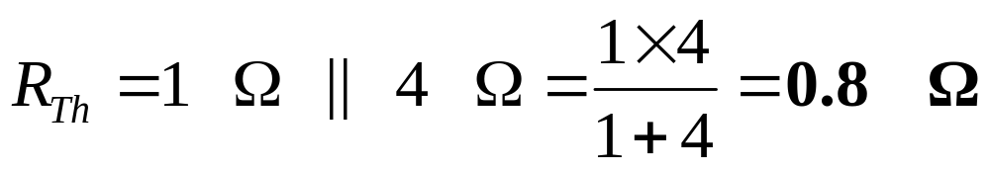
6. Turn OFF all the sources in the circuit
Find the resistance between terminals A and B. This is the Thevenin resistance, R_{Th}. Thus,
Next

Slide 32
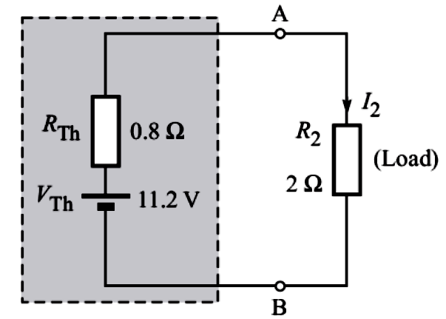
7. The circuit within the dotted box is replaced by the Thevenin’s equivalent, consisting of a voltage source of V_{Th} in series with a resistor R_{Th},
Next

Slide 33
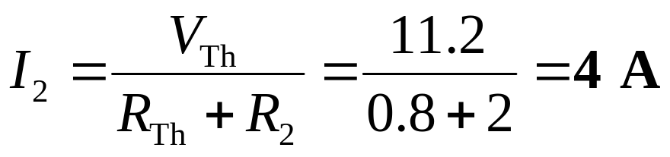
8. The load resistor R₂ is again connected to Thevenin’s equivalent forming a single-loop circuit.
The current I₂ through this resistor is easily calculated,
Important Comment
The equivalent circuit replaces the circuit within the box only for the effects external to the box.
Next

Slide 34
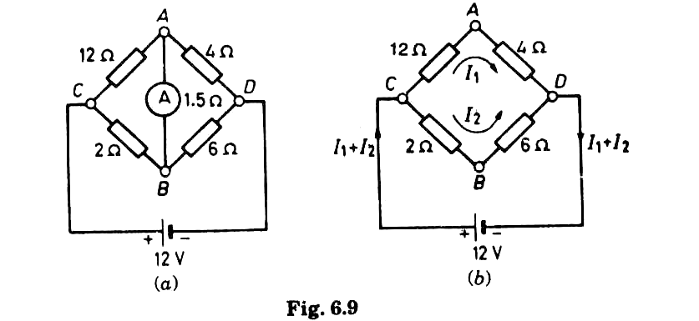
Example 4
Using Thevenin’s Theorem, find the current in the ammeter A of resistance 1.5 Ω connected in an unbalanced Wheatstone bridge shown.
Next

Slide 35

Solution :
Next

Slide 36
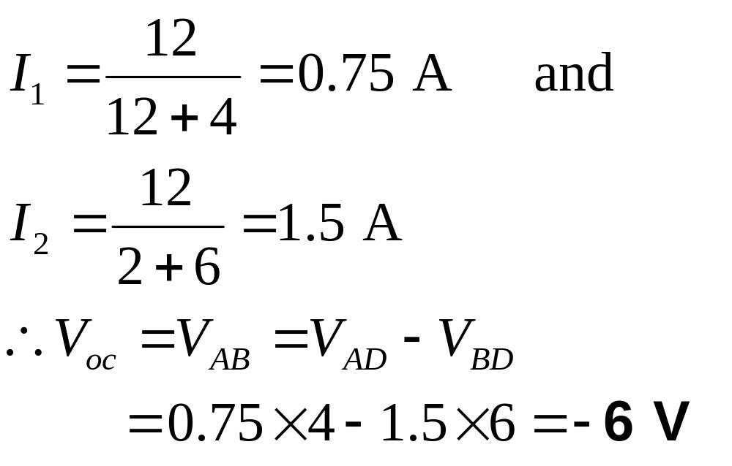
Next

Slide 37
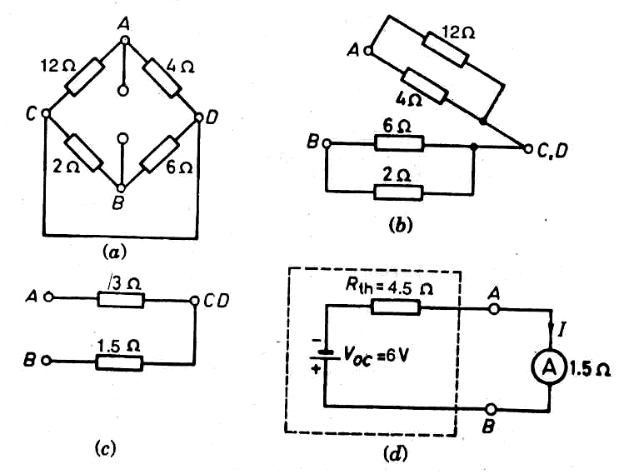
Next

Slide 38
Ans. -1 A
Next

Slide 39
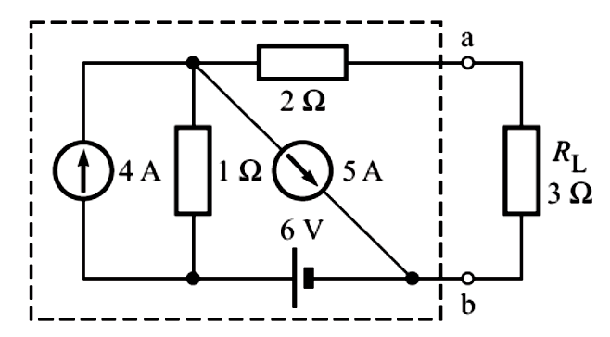
Benchmark Example 5
Again consider our benchmark example to determine voltage across 3-Ω resistor by applying Thevenin’s theorem.
Next

Slide 40
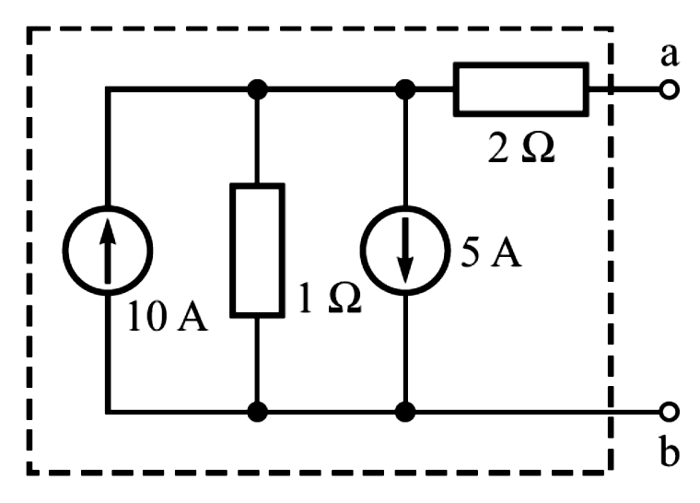
Solution :
We treat the 3-Ω resistor as load.
Thevenin voltage V_{Th} is the open-circuit voltage
(with R_{L} removed).
We use source transformation.
Next

Slide 41
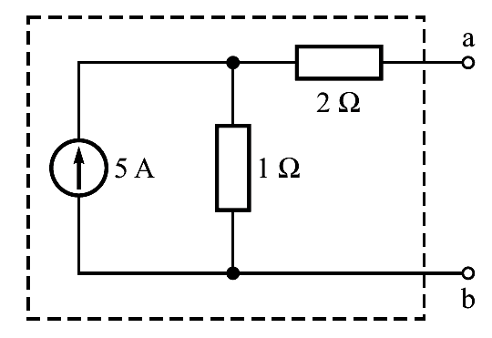

Next

Slide 42
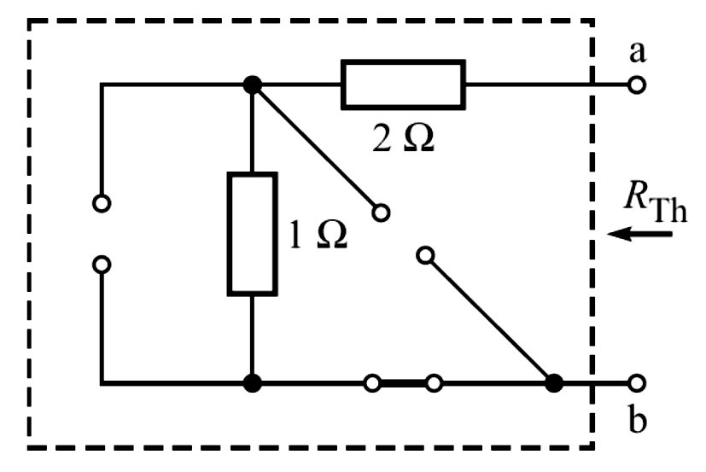
To compute R_{Th}, we turn off all the sources in the circuit within box and get the circuit
Thus, R_{Th} = 3 Ω.
Next

Slide 43
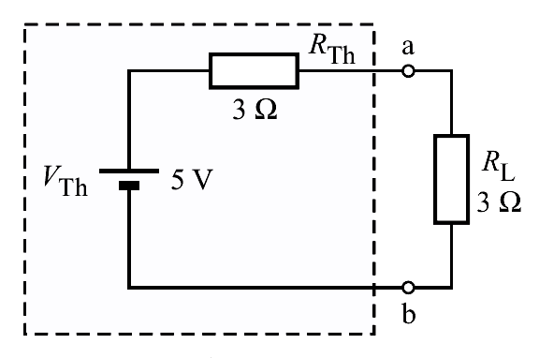
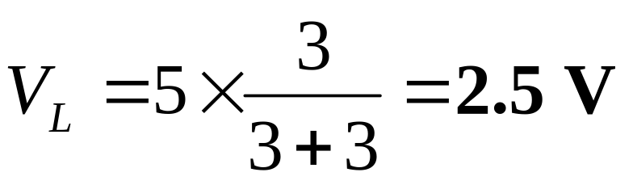
Next

Slide 44
Norton’s Theorem
It is dual of Thevenin’s Theorem.
A two terminal network containing linear passive and active elements can be replaced by an equivalent circuit of a constant-current source in parallel with a resistance.
Next

Slide 45
The value of the constant-current source is the short-circuit current developed when the terminals of the original network are short circuited.
The parallel resistance is the resistance looking back into the original network with all the sources within the network made inactive (as in Thevenin’s Theorem).
Next

Slide 46
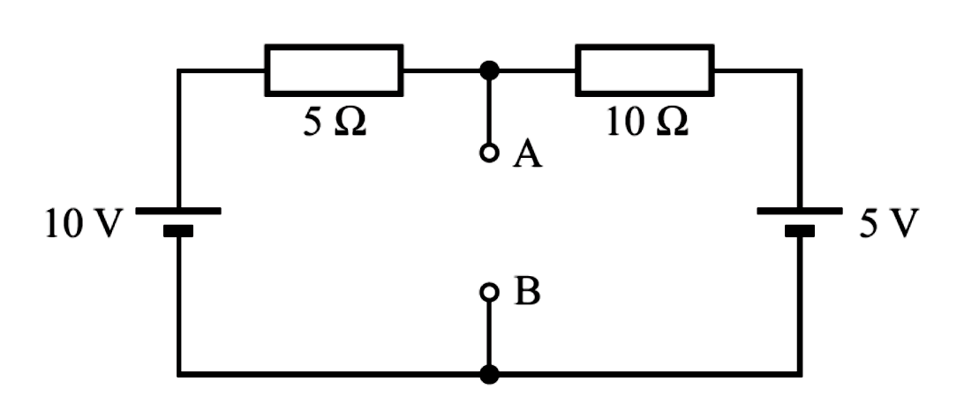
Example 6
Obtain the Norton’s equivalent circuit with respect to the terminals AB for the network shown, and hence determine the value of the current that would flow through a load resistor of 5 Ω if it were connected across terminals AB.
Next

Slide 47
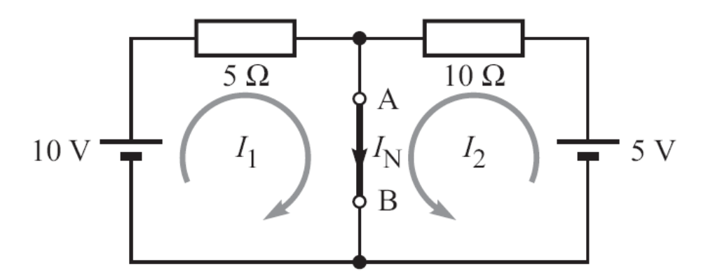
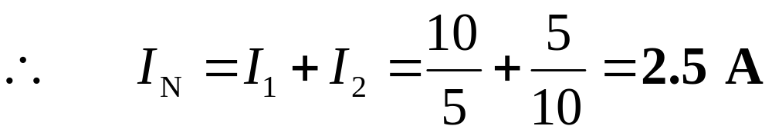
Solution :
When terminals A-B are shorted
Next

Slide 48
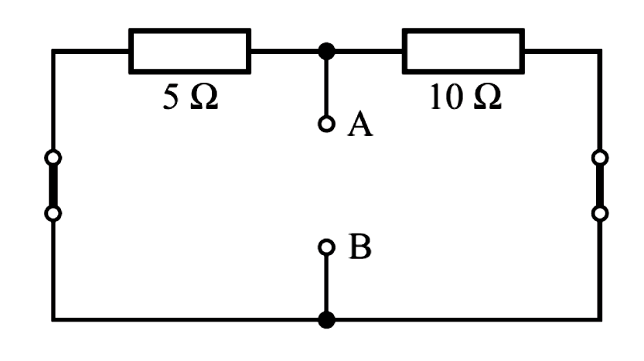
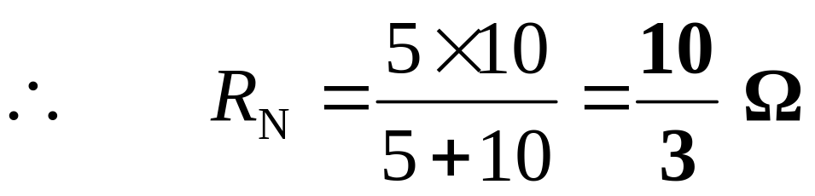
Turning OFF the sources,
Next

Slide 49
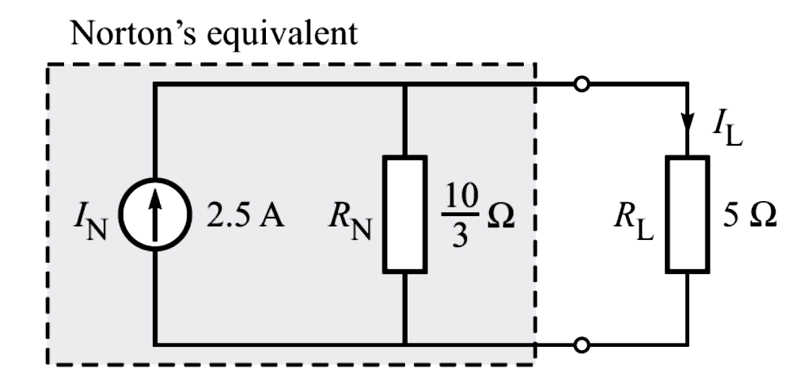
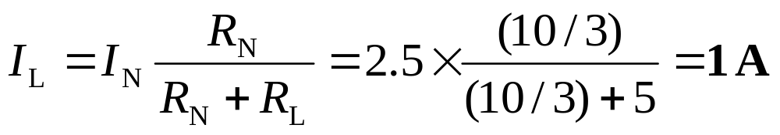
Next

Slide 50
Power Transferred to the Load
Consider the circuit :
r
p
R_{L}
E
(Variable)
Source
Load
Next

Slide 51
p
Maximum power is transferred when R_{L} = r.
p_{max}
0
R_{L} = r
R_{L}
Next

Slide 52
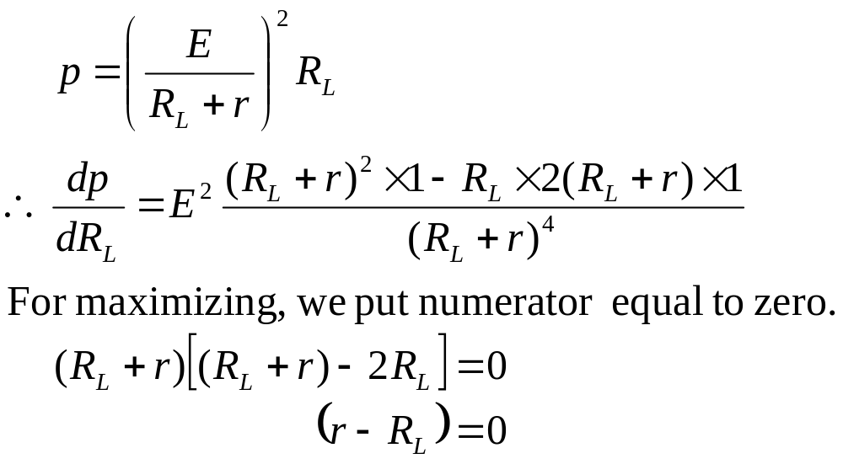
Proof
Next

Slide 53
Maximum Power Transfer Theorem
Maximum power is drawn form a source when the Load Resistance is equal to the Source Internal Resistance.
When maximum power transfer condition is satisfied, we say that the load is matched with the source.
Under maximum power transfer condition, the efficiency of the source is only 50 %.
Next

Slide 54
Available Power
What is the maximum power that a source of emf E and internal resistance r can ever deliver ?
Next

Slide 55
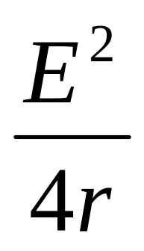
Available Power
What is the maximum power that a source of emf E and internal resistance r can ever deliver ?
Ans.
Next

Slide 56

Prove that under maximum power transfer condition, the efficiency of the source is only 50 %.
Next

Slide 57


Example 7
The open-circuit voltage of a standard car-battery is 12.6 V, and the short-circuit current is approximately 300 A. What is the available power from the battery ?
Solution : The output impedance of the battery,
Therefore, the available power
Next

Slide 58

Maximum Power Transfer Theorem for AC Circuits
Next

Slide 59

Next

Slide 60



The power delivered to the load is
Phasor current and voltage are
where
Next

Slide 61


Next

Slide 62
A little forethought saves us some work. (X_{Th} + X_{L}) absorbs no power; any nonzero value only reduces P_{L}. Hence we can put X_{L} = - X_{Th}, so as to get
Next

Slide 63


This expression, we have already maximized for purely resistive case, by selecting R_{L} = R_{Th.} Hence, we must have
Next

Slide 64

Exercise
Show that if the load is purely resistive in an ac circuit, the condition for maximum power transfer is
Next

Slide 65

Millman’s Theorem
A number of parallel voltage sources V₁, V₂, V₃ …, V_{n} with internal resistances R₁, R₂, R₃…, R_{n}, respectively can be replaced by a single voltage source V in series with equivalent resistance R.
Next

Slide 66



Equivalent Circuit
and
Next

Slide 67
Reciprocity Theorem
In a linear bilateral network, if a voltage source V in a branch A produces a current I in any other branch B, then the same voltage source V acting in the branch B would produce the same current I in branch.
The ratio V/I is known as the transfer resistance.
Let us verify the reciprocity theorem by considering an example.
Click
Next

Slide 68
Example 8
In the network shown, find the current in branch B due to the voltage source of 36 V in branch A.
Now transfer the voltage source to branch B and find the current in branch A.
Is the reciprocity theorem established ?
0Also, determine the transfer resistance from branch A to branch B.
Next

Slide 69

Solution : The equivalent resistance for the voltage source,
Next

Slide 70


The current supplied by the voltage source = 36/9 = 4 A. Using current divider, the current I in branch B,
Now, transferring the voltage source to branch B,
Next

Slide 71


The equivalent resistance for the voltage source,
The current supplied by the voltage source = 36/8 = 4.5 A. Using current divider, the current I’ in branch A,
The transfer resistance
Next

Slide 72
Review
Superposition Theorem.
Thevenin’s Theorem.
Norton’s Theorem.
Maximum Power Transfer Theorem.
Maximum Power Transfer Theorem for AC Circuits.
Millman’s Theorem.
Reciprocity Theorem.
Next

